Slide 1
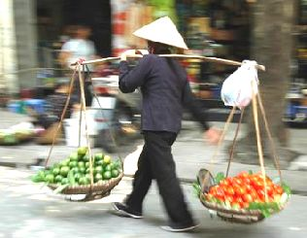
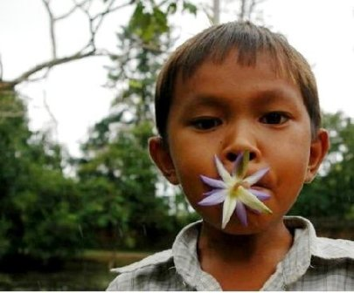
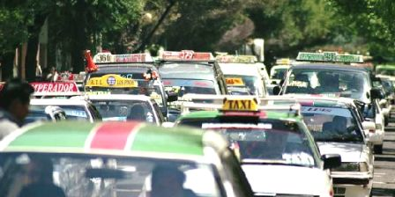
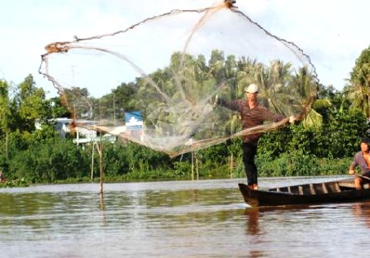
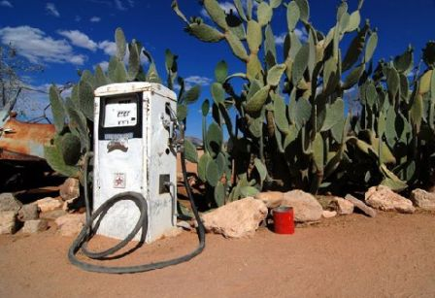
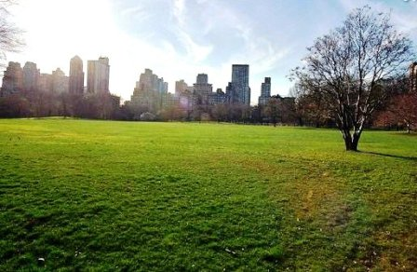
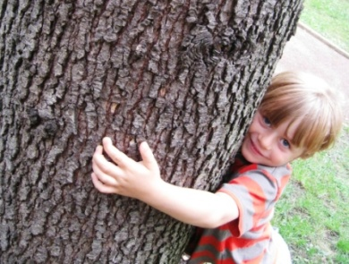
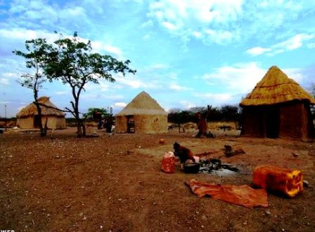
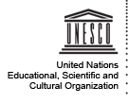
photos: www.dawide.com
Future Earth
Research for Global Sustainability

Slide 2
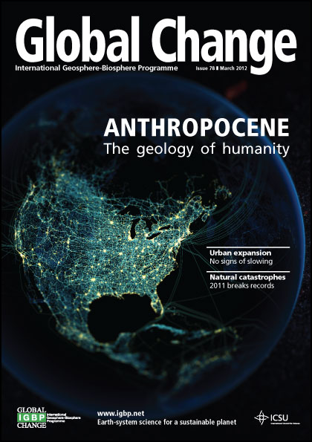

Slide 3
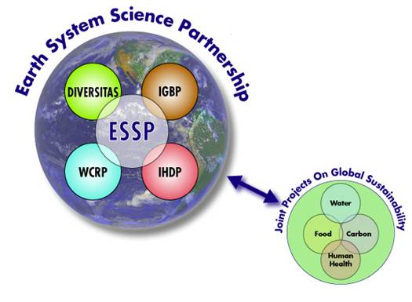
Future Earth: building from the GEC programmes
Global Environmental Change Programmes
FUTURE
EARTH
1991
1980
1986
1996
2001
2013
and their partnership

Slide 4
Some of the challenges we face
Feeding 9 billion people within sustainable planetary boundaries
Valuing and protecting nature’s services and biodiversity
Adapting to a warmer and more urban world
Transitioning to low carbon societies
Providing income and innovation opportunities through transformations to global sustainability
Reducing disaster risks
Aligning governance with stewardship

Slide 6
A 10-year initiative by a new global Alliance
Future Earth:
research for global sustainability
WMO is an observer

Slide 7
Future Earth
To provide the knowledge required for societies in the world to face risks posed by global environmental change and to seize opportunities in a transition to global sustainability

Slide 8
Future Earth: can we answer ...
How and why the global environment is changing, what are likely future changes, what the implications are for human wellbeing and other species, what choices can be made to reduce harmful risks and vulnerabilities and enhance resilience, and how this knowledge can support decisions and sustainable development?

Slide 9
The challenges of global environmental change and sustainable development require some new approaches which are:
More international
More integrated
More collaborative
Co-designed with users, funders…
More responsive to society and grand challenges of sustainability
Builds on the success of current international research programmes

Slide 10
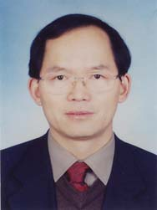
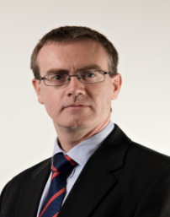
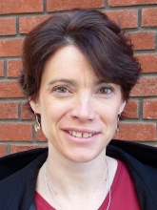
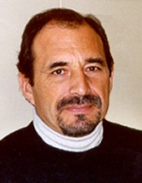
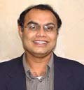
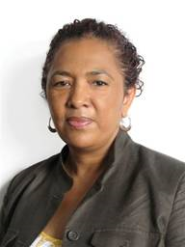
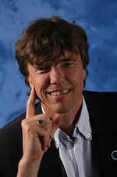
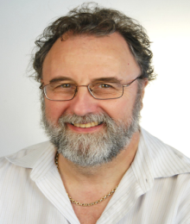
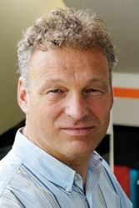
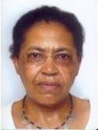
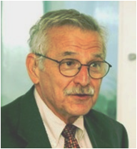
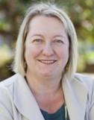
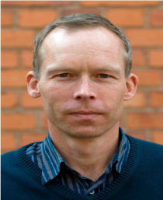
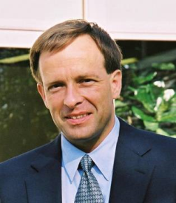
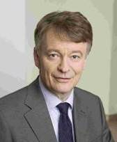
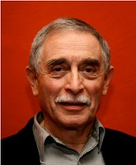
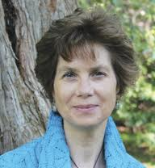
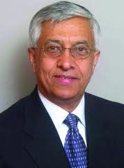
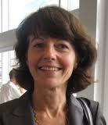
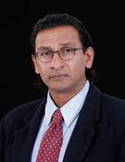
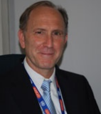
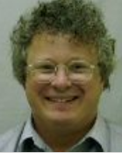
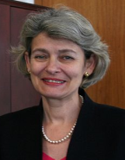
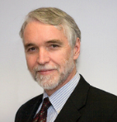
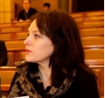
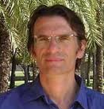
The Transition Team
Many disciplines, sectors, regions
for a truly new co-design effort
17 individual capacity members, 12 ex-officio (ICSU, ISSC, Belmont Forum, UNESCO, UNU, UNEP)
and Global Environmental Change Programme Directors
10

Slide 11
Conceptual framework for Future Earth

Slide 12
Proposed Integrated Research Themes
The State of the Planet: Observing, explaining, projecting Earth and societal system trends, drivers, and processes and their interactions
Responses to global environmental change: Understanding and evaluating current strategies for governing and managing the global environment across scales and sectors
Reducing Risks: Anticipating global thresholds, improving resilience and reducing disaster risks
Resources for development and wellbeing: Providing the knowledge for sustainable, secure and fair stewardship of food, water, health, energy, materials and other ecosystem services
Pivotal Places: Understanding global change in cities, regions, and critical biomes
Living with the Sea: Oceans, coasts and blue societies
Transformative Pathways: Towards a Sustainable Future Earth
…
Note: IRTs to be finalized through consultations

Slide 13
Crosscutting capabilities
Observing systems
Data systems
Earth system models
Theory development
Synthesis and assessments
Capacity development and education
Communication and the science-policy interface

Slide 14
Crosscutting capabilities
Observing systems
What are the Earth observing needs of the social science community, and how can GEOSS help?
What new challenges will integrated science bring to observing requirements?
How can Future Earth help make the argument for sustained observations?

Slide 15
Future Earth: next steps
Early actions
Launch – PuP and Rio+20
Belmont Collaborative Research Actions on coasts and water
ISSC transformations to sustainability project
Consultations – second half 2012
Research Framework
Projects and programmes
Regional perspectives

Slide 16
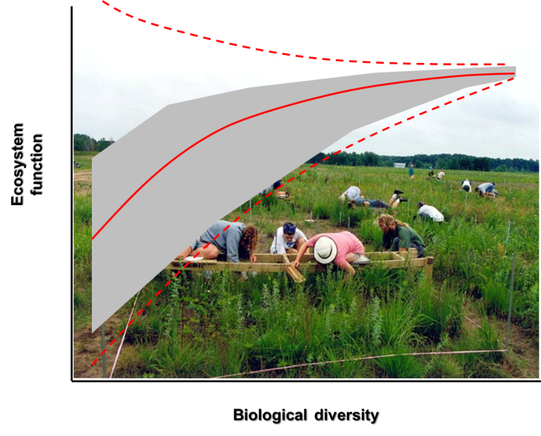
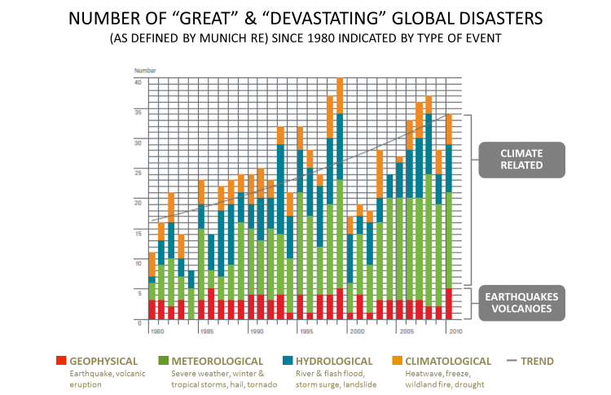

Slide 17
Rio+20 Accord V. Framework for Action and follow-up
A.Thematic areas and cross-cutting issues
Poverty eradication
Food security …
Water and sanitation
Sustainable cities …
Oceans and seas
Disaster risk reduction
Climate change
Forests
Desertification …
…

Slide 18
Transition Team deliverables
An initial research framework
An institutional design
A strategy for outreach, education, stakeholder engagement
A name for the initiative

Slide 19
Living with the sea: oceans, coasts and blue societies - Example research questions
What might adaptive management strategies contribute to resilient coastal zones?
How much and what kind of food will the oceans provide to future societies?
What is the capacity of the ocean to take up CO₂?
How to govern sustainable fisheries?
How do land-use and open ocean changes influence coastal habitats and marine biodiversity?
What are the regional impacts of sea level rise and their interaction with coastal use and protection?

Slide 20
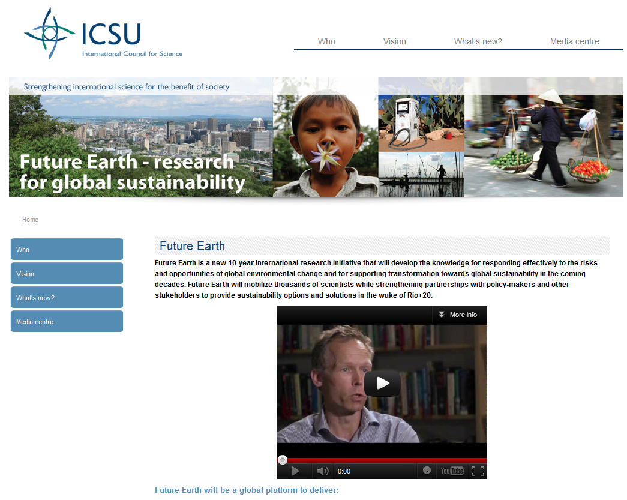
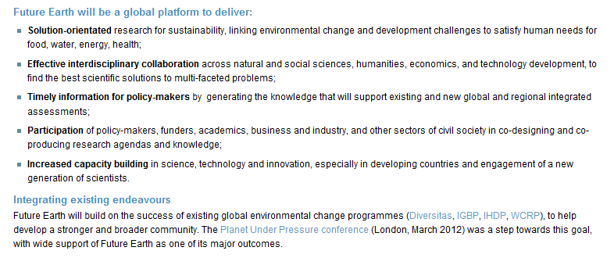
For more information on Future Earth
www.icsu.org/future-earth
www.icsu.org/future-earth

